Slide 1
Image Super resolution
Team # 11
Team Members:
Avinav Srivastava – 20173014
Sreenivasan M – 20173013
Greenu Sharma – 20173032
Nararaju Gundala – 20173027

Slide 2
Problem statement
Estimation of Low resolution image to higher resolution
Useful in many military and civilian applications, like surveillance, auto target recognition, forensic and satellite imaging.

Slide 3
Methods
K - Nearest Neighbor
Convolution Neural Network
Support Vector Regression

Slide 4
Nearest neighbor
HR Image
LR Image & Down Scaled
Upscaled
Bi Cubic Interpolated
Difference
Computation
Generate Training Set
LR/Test Image
Upscaled
Bi Cubic Interpolated
KNN Computation
Reconstruction Of Image
HR Image

Slide 7
Convolution neural network
HR Image
LR Image & Down Scaled
Upscaled
Bi Cubic Interpolated
CNN/SRCNN
Learning
Generate Model
LR Image
Upscaled
Bi Cubic Interpolated
CNN Prediction
Reconstructed Image
HR Image

Slide 8
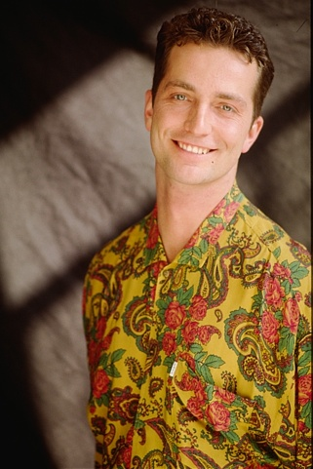


SRCNN: Image comparison PSNR: 29.69
HR IMAGE
INTERPOLATED IMAGE
PREDICTION IMAGE

Slide 9
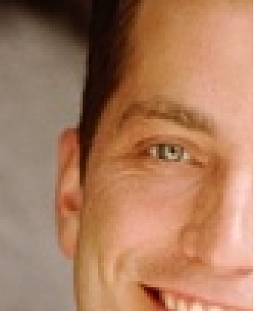

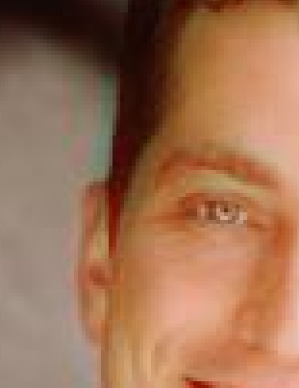
SRCNN: ZOOMED COMPARISION
HR IMAGE
INTERPOLATED IMAGE
PREDICTION IMAGE

Slide 10
Space vector regression
HR Image
LR Image & Down Scaled
Upscaled
Bi Cubic Interpolated
SVR
Learning
Generate Model
LR Image
Upscaled
Bi Cubic Interpolated
SVR Prediction
Reconstructed Image
HR Image

Slide 13
Measurement Metrics

